Slide 1



LIVE SESSION #1 UNIT 1A: “WHERE ARE YOU FROM?” UNIT 1B: “CHARLOTTE’S CHOICE”
PROFESSOR ROSIBEL ACUÑA CALDERÓN
ENGLISH INTENSIVE 2
V, 2021

Slide 2
TODAY’S AGENDA
Presentation, introduction
Course program, methodology, evaluation, class and program rules
Warm up activity
Grammar reminder #1: Word order in questions
Communicative activity #1
Communicative activity #2
Grammar reminder #2: Simple past
Vocabulary reminder: describing people vocabulary, verbs for people’s description, adjective order
Communicative activity #3
Communicative activity #4
Listening p.7
Feedback and questions
Important reminders

Slide 3
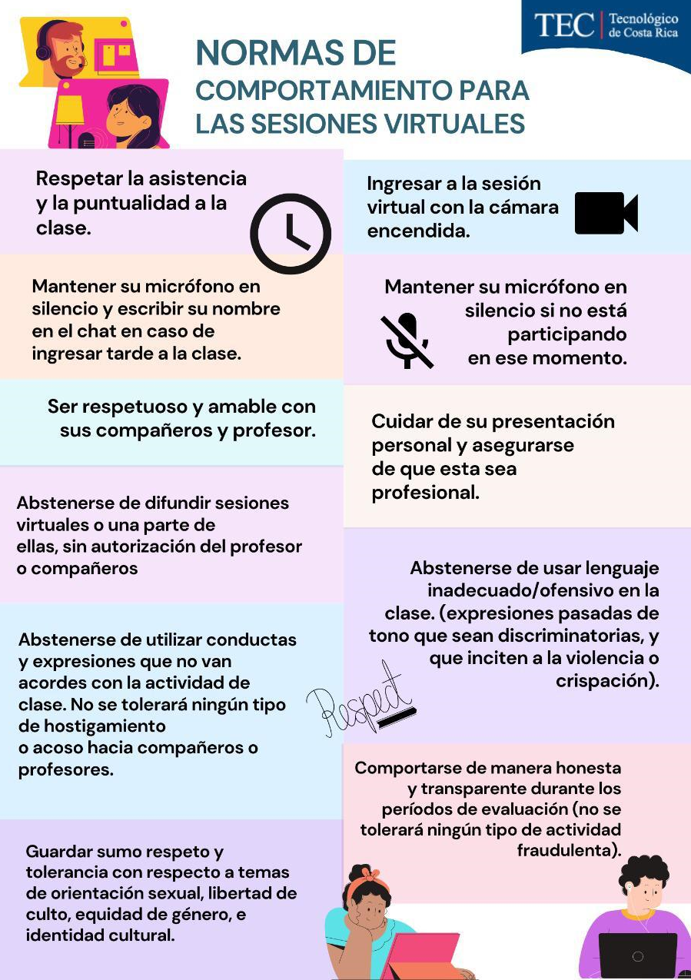

CLASS RULES AND IMPORTANT ASPECTS

Slide 4
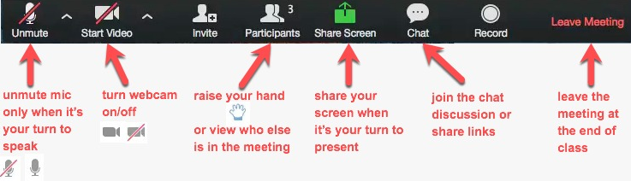
ZOOM FUNCTIONS

Slide 5
COURSE PROGRAM AND EVALUATION
Zoom Sessions 21%
Listening Quizzes 12%
Speaking activities 24%
Written quiz 8%
Homework 5%
Final Written 10%
Final Listening 10%
Final Oral 10%
Total 100%
SEE COURSE PROGRAM AND EVALUATION CHRONOGRAM FOR DETAIL

Slide 6
METODOLOGÍA
3 HORAS DE CONEXIÓN POR ZOOM + 1 HORA DE AUTOESTUDIO (EJERCICIOS DE LAS UNIDADES CUBIERTAS POR DIA, EJERCICIOS EXTRA, VIDEOS, TECDIGITAL)
Se contará con una plataforma como base:
TEC Digital: Para acceder a la misma usted debe dirigirse a la página: https://tecdigital.tec.ac.cr/ Los datos de acceso para cada estudiante son
Usuario: correo electrónico
Contraseña: número de cédula
En la plataforma encontrará los contenidos de cada semana, material de apoyo como videos y cualquier otro material o actividades extra que indique la docente. Las encontrará dando clic en el icono de cada semana.
En la plataforma también podrán acceder a las actividades de evaluación en la pestaña “Evaluaciones”.
A través de la plataforma se realizarán las entregas de las dos tareas contempladas en la evaluación (sin excepción)

Slide 7
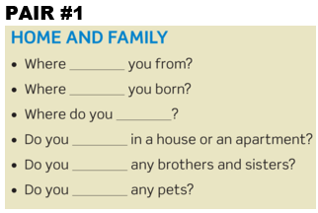
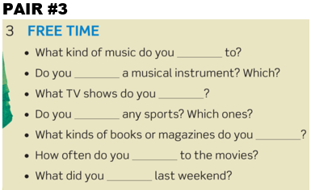
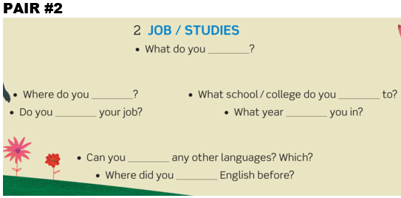
WARM UP ACTIVITY INSTRUCTIONS: Students get in pairs. Each pair completes the assigned questions and take turns asking each other the questions. Then, come back to the main session, read the questions and give the report of the answers.

Slide 8
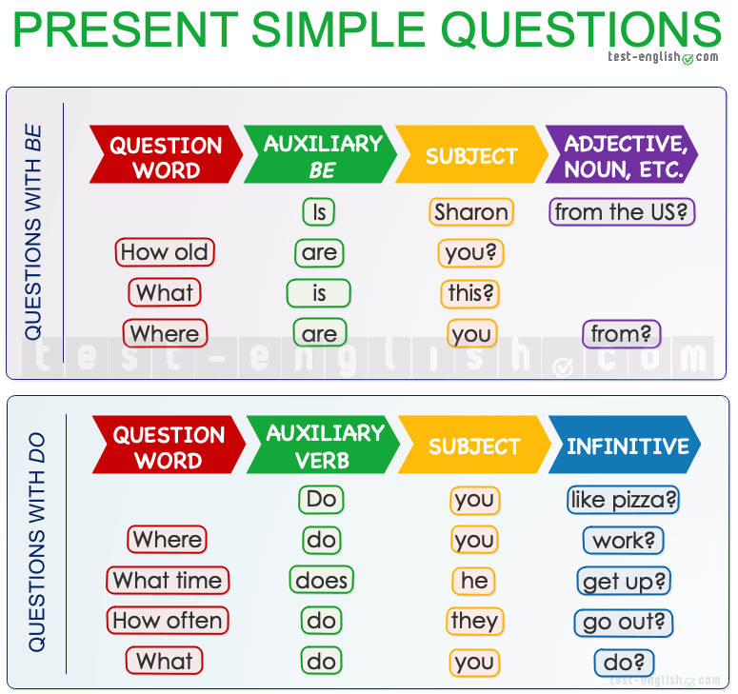
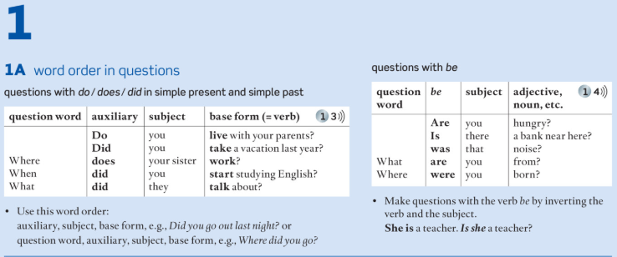
GRAMMAR REMINDER #1: WORD ORDER IN QUESTIONS
Go to page 126 Section Grammar Bank 1A
Complete exercises a and b
Check your answers

Slide 9
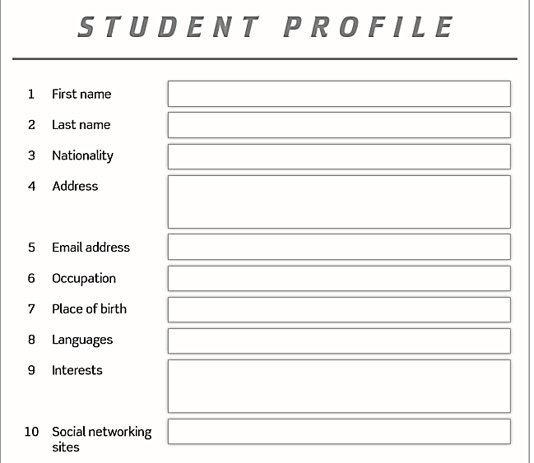
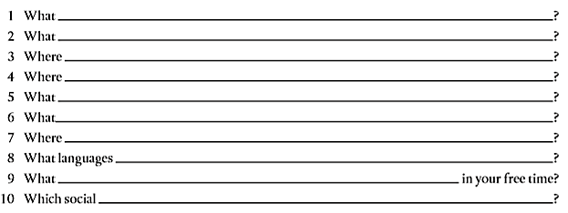
COMMUNICATIVE ACTIVITY #1
INSTRUCTIONS: Individually, students complete the 10 given information questions in order to fill out the Student Profile. The teacher breakout the group into groups of three people. Each student interviews two classmates and get information to get their profiles. Students come back to the main session and share their classmmates’ profiles by giving a short report.

Slide 10
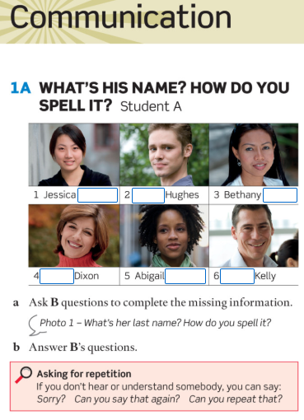
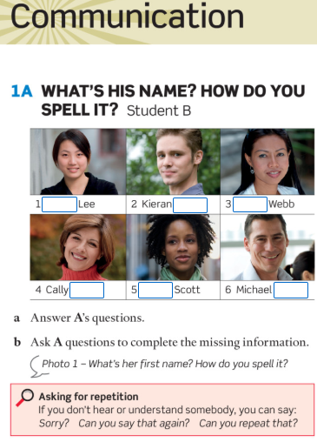
COMMUNICATIVE ACTIVITY #2 (p.5)
INSTRUCTIONS:
Get in pairs.
Decide who is student A and who is student B
Students A go to page 100, section 1A: What’s his name? How do you spell it?
Students B: Go to page 106, section 1A: What’s his name? How do you spell it?
Follow the instructions and do the activity.
Get back to the main session and check your answers.

Slide 11
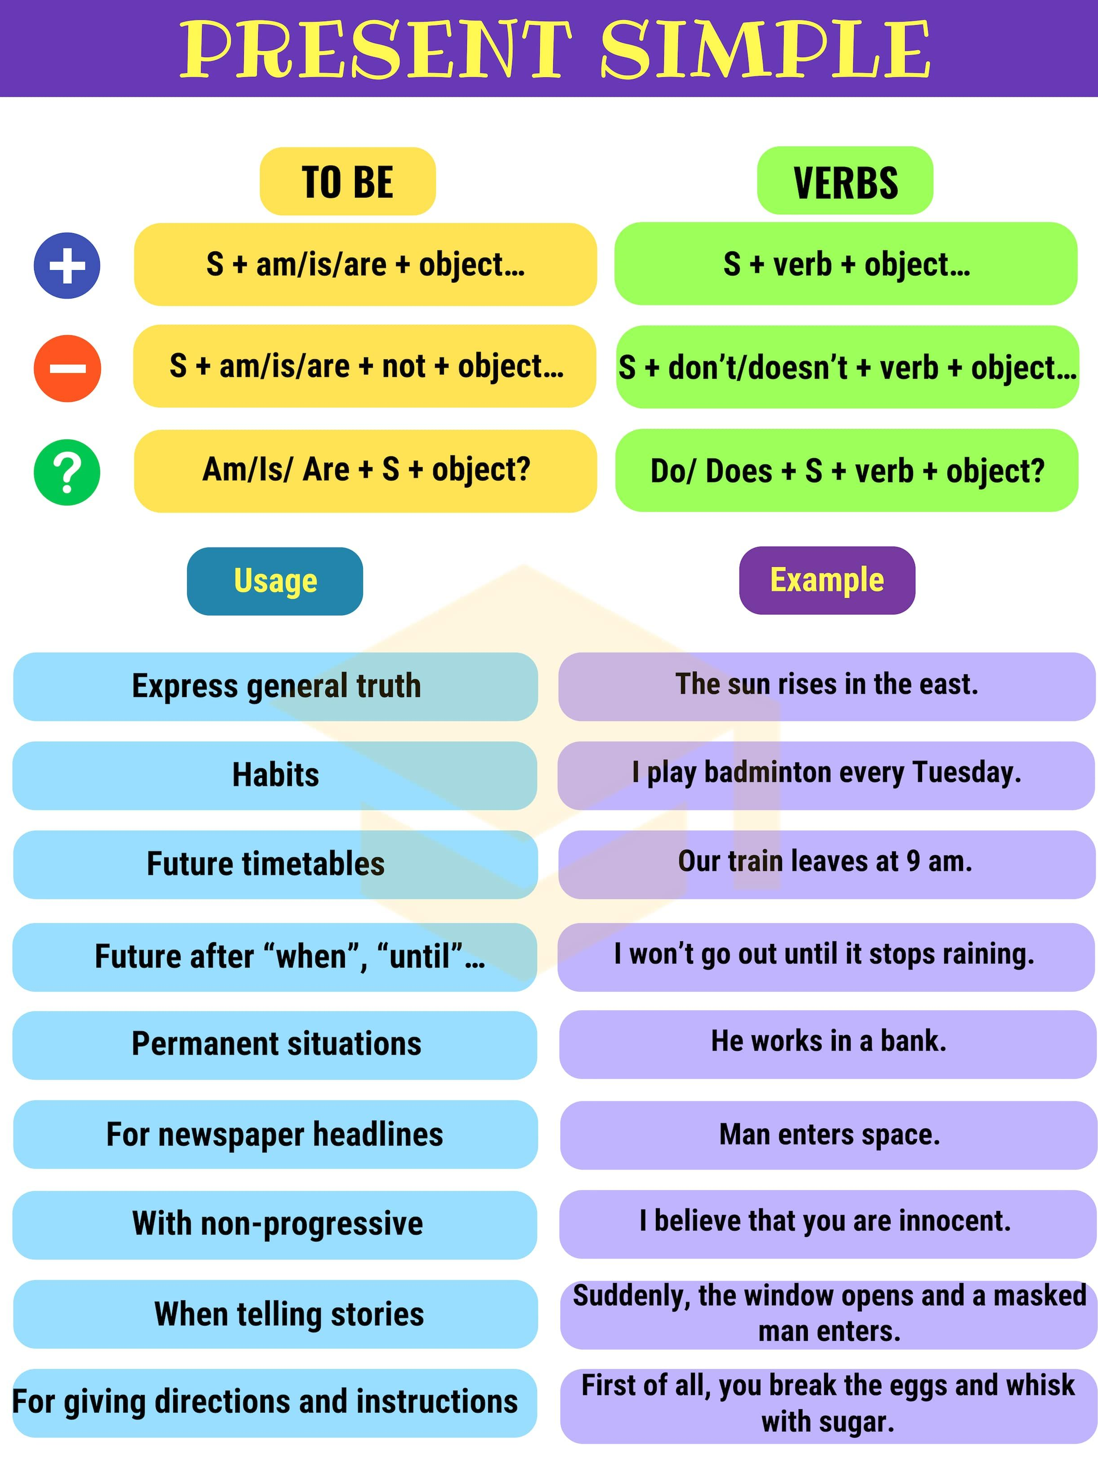
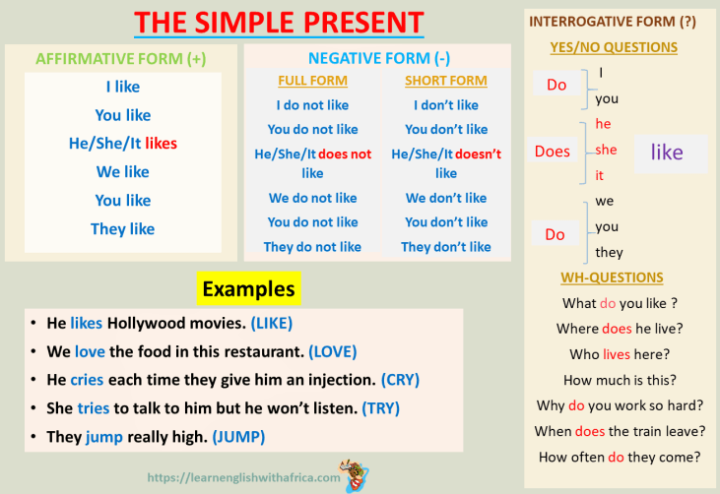
GRAMMAR REMINDER #2: SIMPLE PRESENT

Slide 12
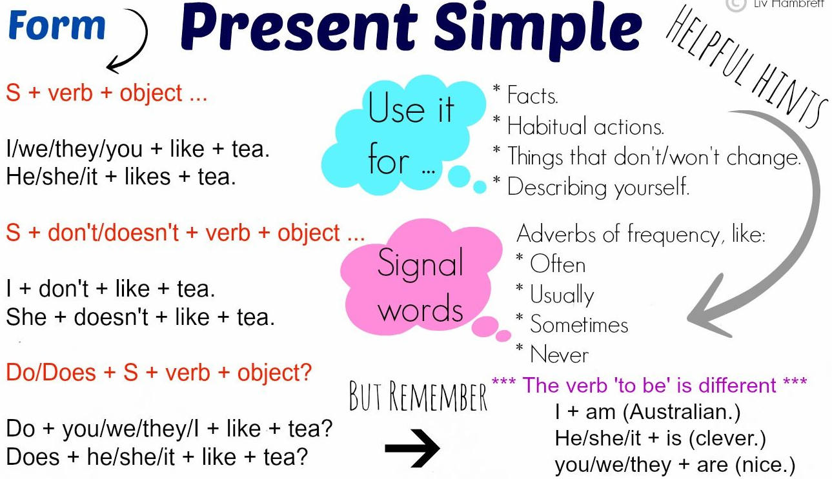
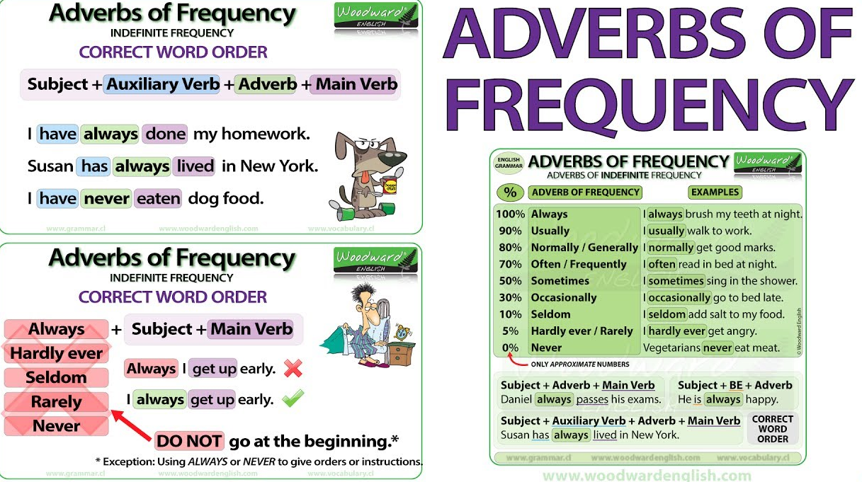
GRAMMAR REMINDER #2: SIMPLE PRESENT
Go to page 126 Section Grammar Bank 1B
Complete exercises a and b
Check your answers

Slide 13
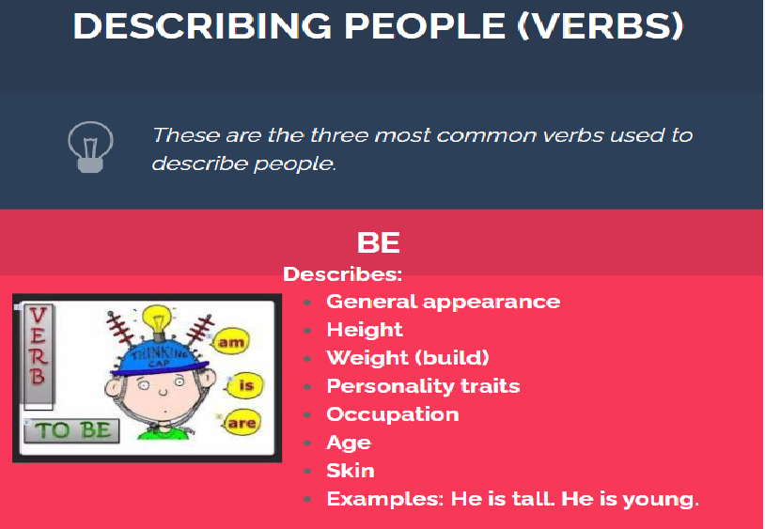
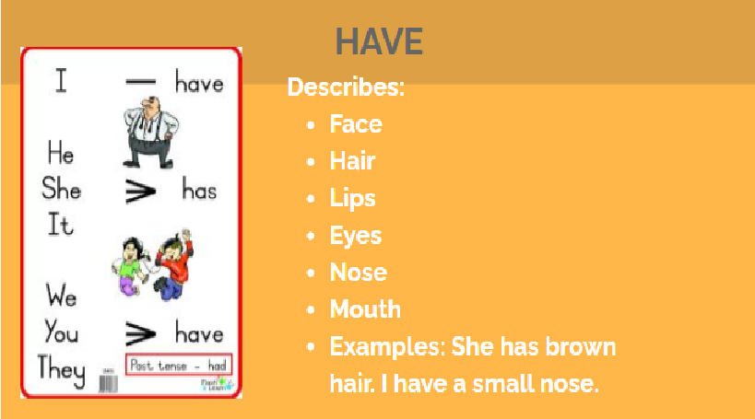
DESCRIBING PEOPLE
What is she like? /What’ s she like?
What are you like?
I’m a beautiful, tall, slim, young, brunette, Costa Rican woman.
I have long, straight, brown hair.
I have medium, oval, brown eyes.
SEE VOCABULARY ON PAGE 150

Slide 14
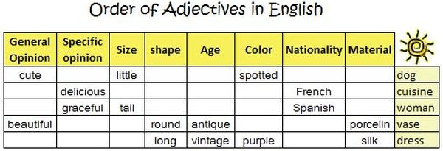
ADJECTIVE ORDER

Slide 15
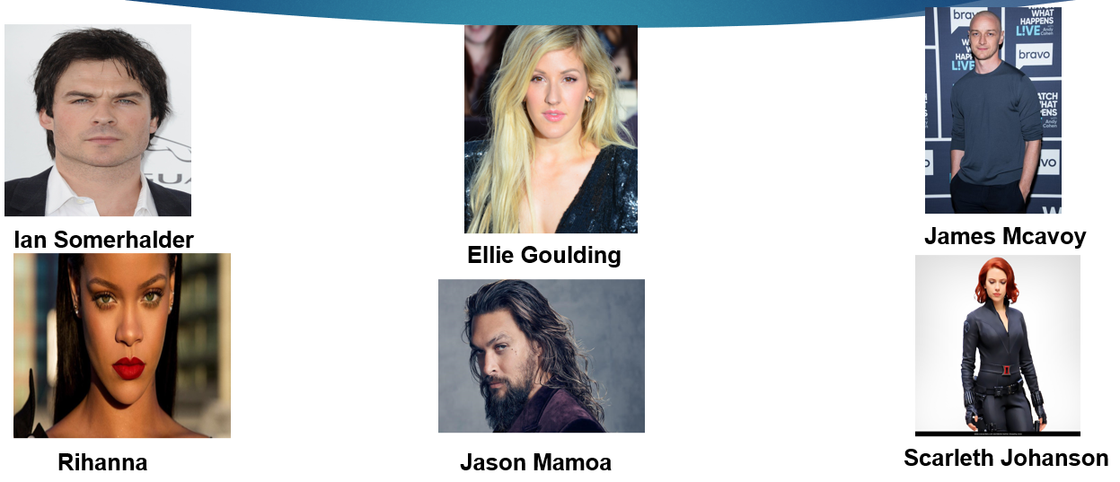
COMMUNICATIVE ACTIVITY #3
INSTRUCTIONS: Get in pairs. Look at the famous people pictures. Individually, prepare a description of this person (physical characteristics, clothing, personality traits). Describe the person without saying the name. Your classmate guesses who is the person. Take turns describing and guessing.

Slide 16
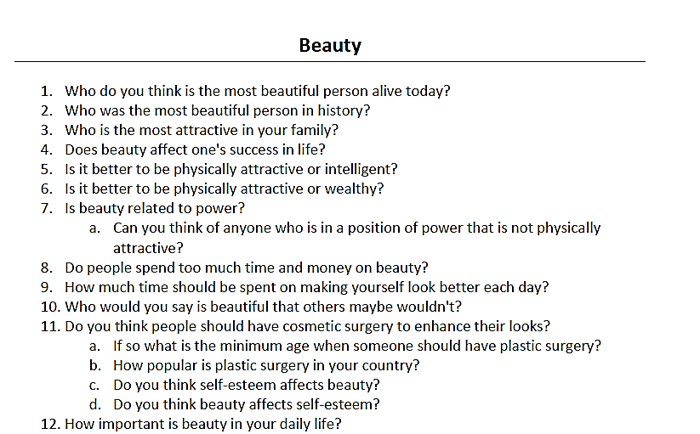
COMMUNICATIVE ACTIVITY #4
INSTRUCTIONS:
Get in pairs.
Talk about the given questions.
Share your opinions
Get back to the main session and share a short report.

Slide 17
LISTENING P.7
Go to page 7 Section 4 Listening
Complete exercises a, b, c, d
Check your answers

Slide 18
FEEDBACK AND QUESTIONS

Slide 19
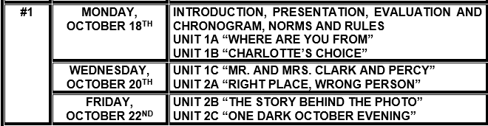
IMPORTANT REMINDERS
Complete exercises from UNITS 1A and 1B from both the Students’ book and the Workbook.
Study grammar and vocabulary from Units 1C and 2A from the Students’ Book for next class.
Check course chronogram for weekly activities:

